Slide 1
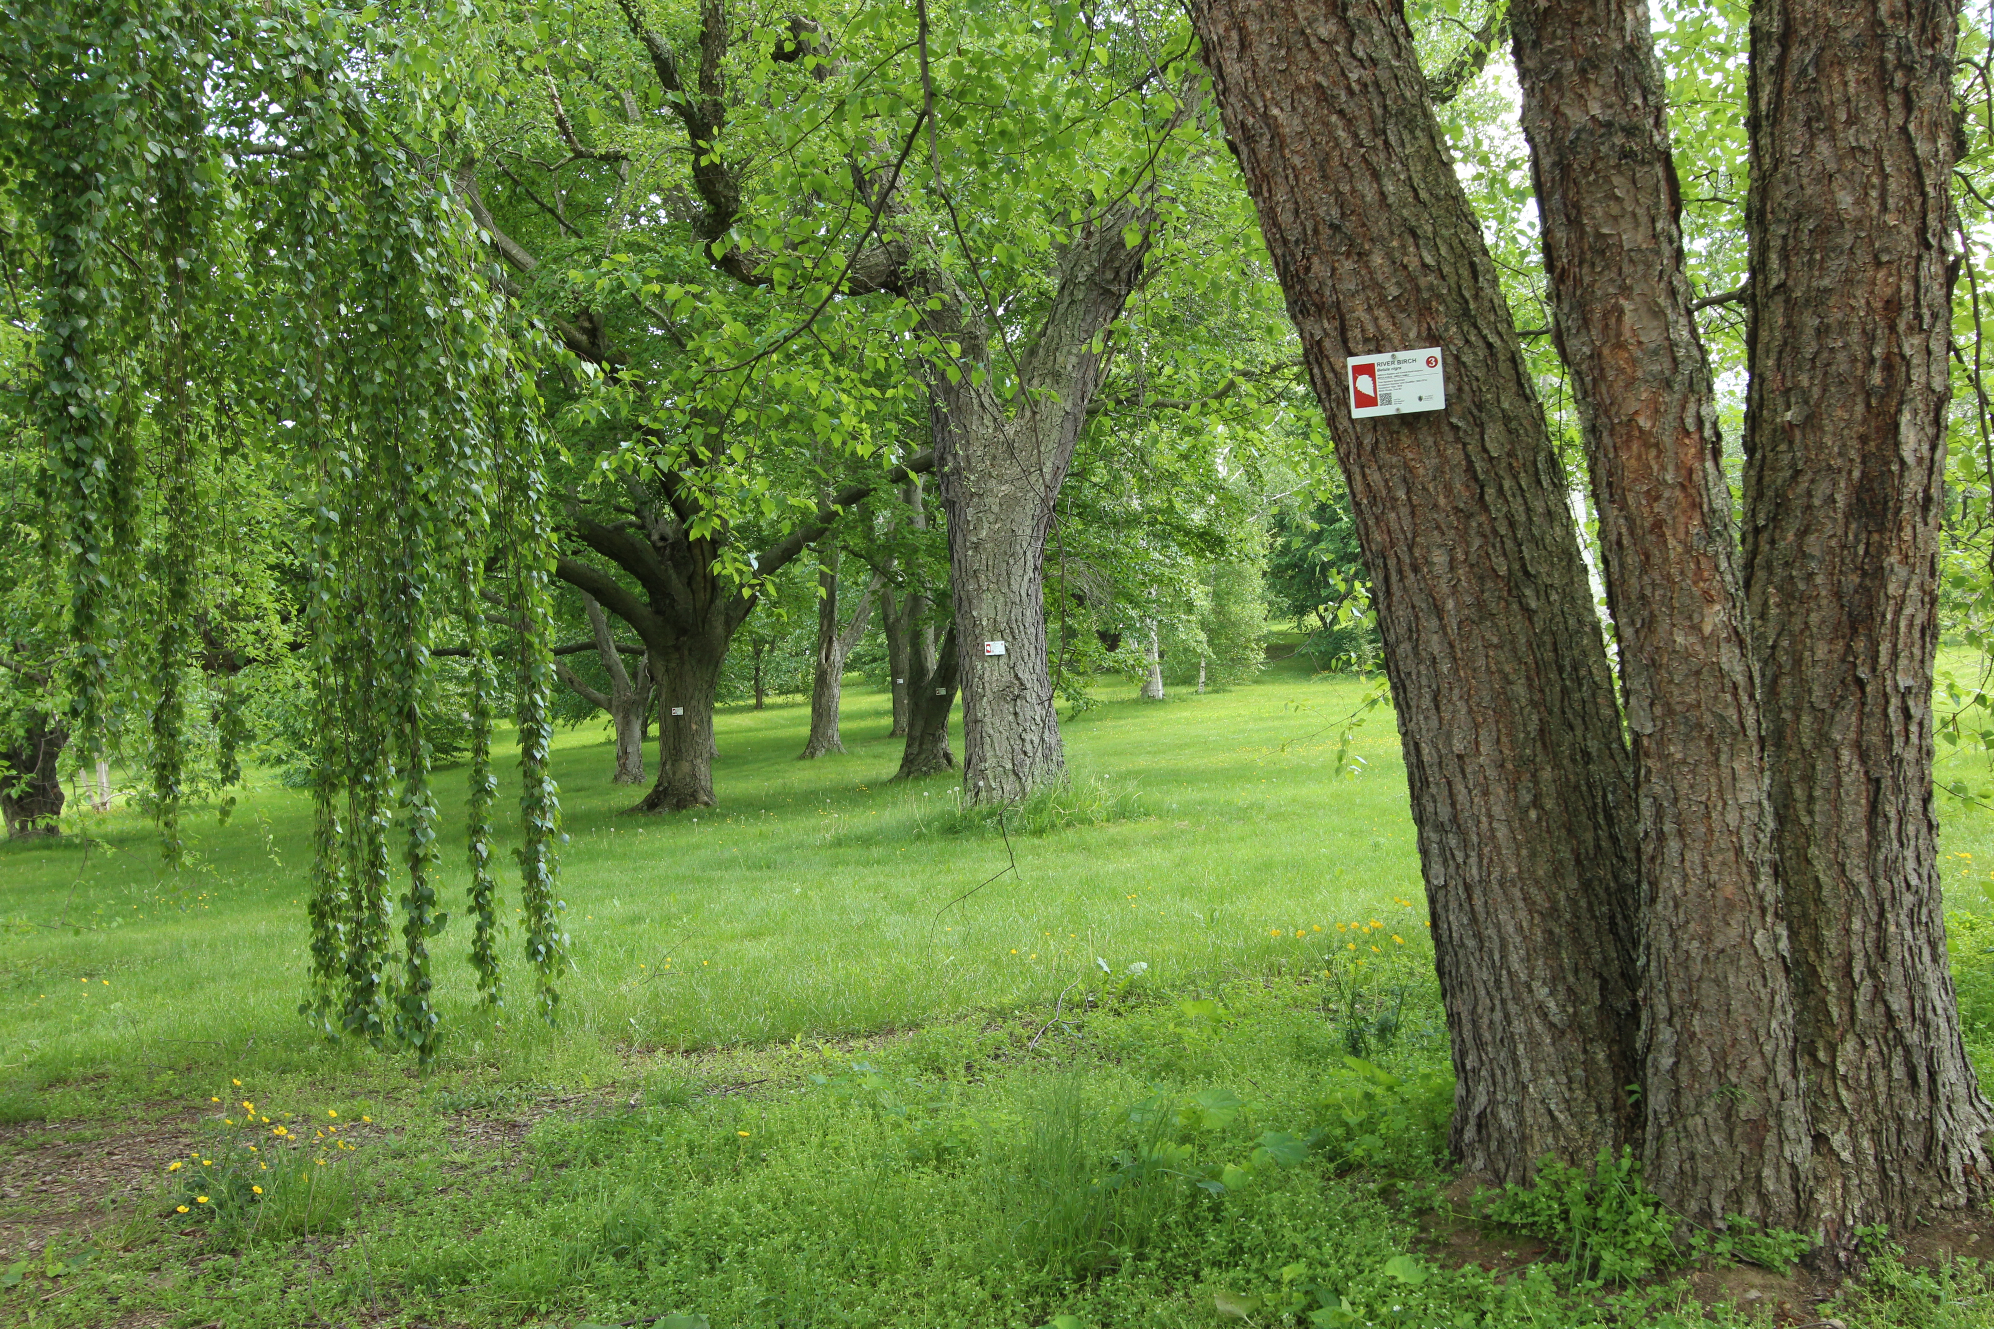




Tree Spotters 2018 BBQ
Arnold Arboretum
Temporal Ecology Lab, Harvard University
Cat Chamberlain, Graduate Student
Suzanne Mrozak, Volunteer Coordinator
Danny Schissler, Intern

Slide 2
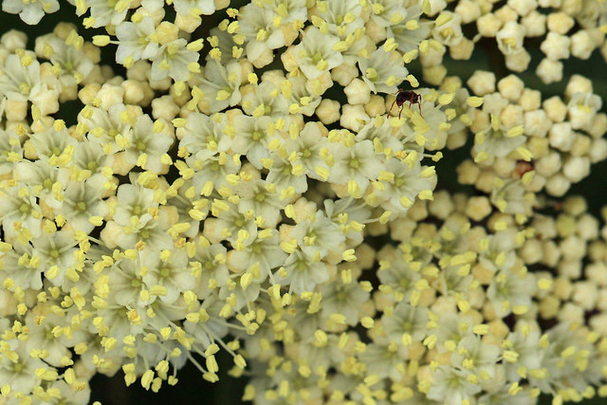
OVERVIEW
2018 SPRING REVIEW
AMAZING DATA!
SOME RESEARCH PLANS
NEW SPECIES ROLL-OUT
WHAT DO YOU WANT TO KNOW?
THANK YOU!

Slide 3
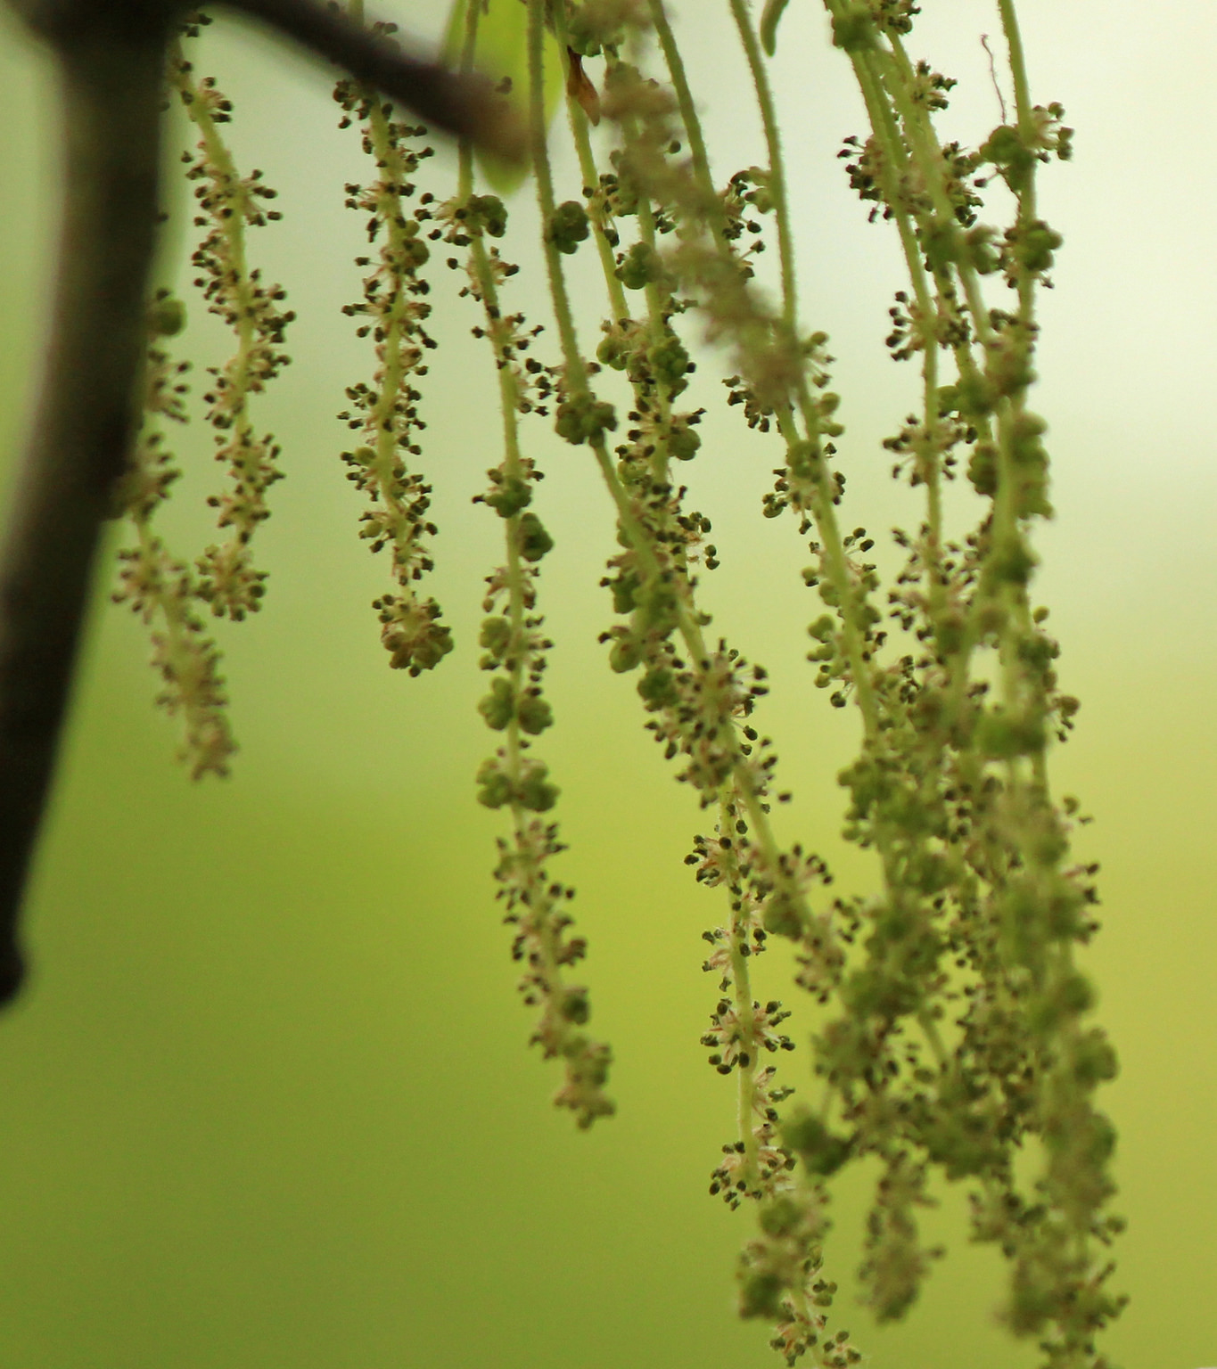
THE NUMBERS
OBSERVATIONS FOR…
2016:
53,502
2017:
66,112
2018:
33,021
165,200
TOTAL:

Slide 4
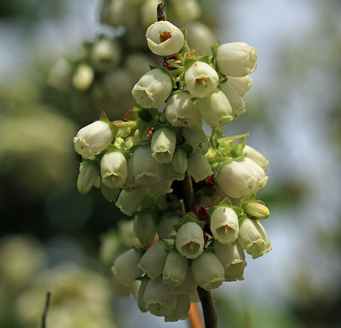
THE NUMBERS
OF THE 58 WHO HAVE OBSERVED IN 2018…
OBSERVERS FOR…
2016:
62
39.7% Joined this Year
2017:
74
34.5% Since 2017
2018:
58
25.9% Since 2016
153
TOTAL:

Slide 5
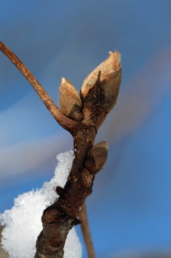
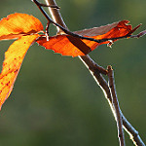
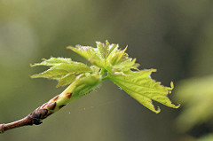
PHENOLOGY:
the timing of recurring life history events
Paradormancy to Endodormancy
Bud swell to Budburst to Leafout
COLD HARDINESS:
Freezing resistance through the phenophases
Endodormancy to Ecodormancy
Charrier & Améglio, 2011; Vitasse et al., 2014
Notes:
During freezing, xylem forms ice lattices which pushes out dissolved gases and solutes together, forming bubbles, when the xylem thaws again, that bubble risks cavitation. The bigger the pit, the bigger the risk because of the likelihood that the bubble will have a larger radius

Slide 6
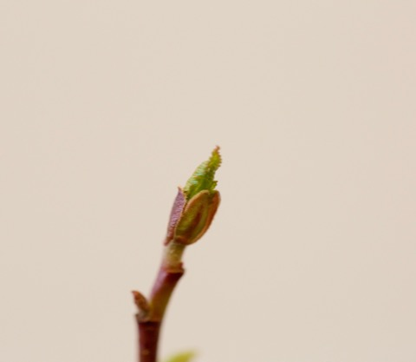
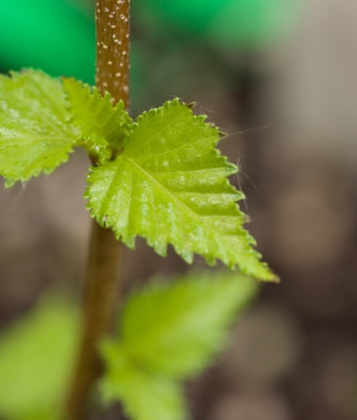
Alnus incana - budburst
False Spring: Defined
Interested in time between leaf budburst and leafout,
when frost resistance is lowest but risk is still relatively high.
BUDBURST
LEAFOUT
DURATION OF VEGETATIVE RISK
Betula populifolia - leafout
Lenz et al, 2013; Menzel et al., 2015

Slide 7
DURATION OF VEGETATIVE RISK:
OVER THE PAST 3 YEARS

Slide 8
DURATION OF VEGETATIVE RISK: breakdown

Slide 9
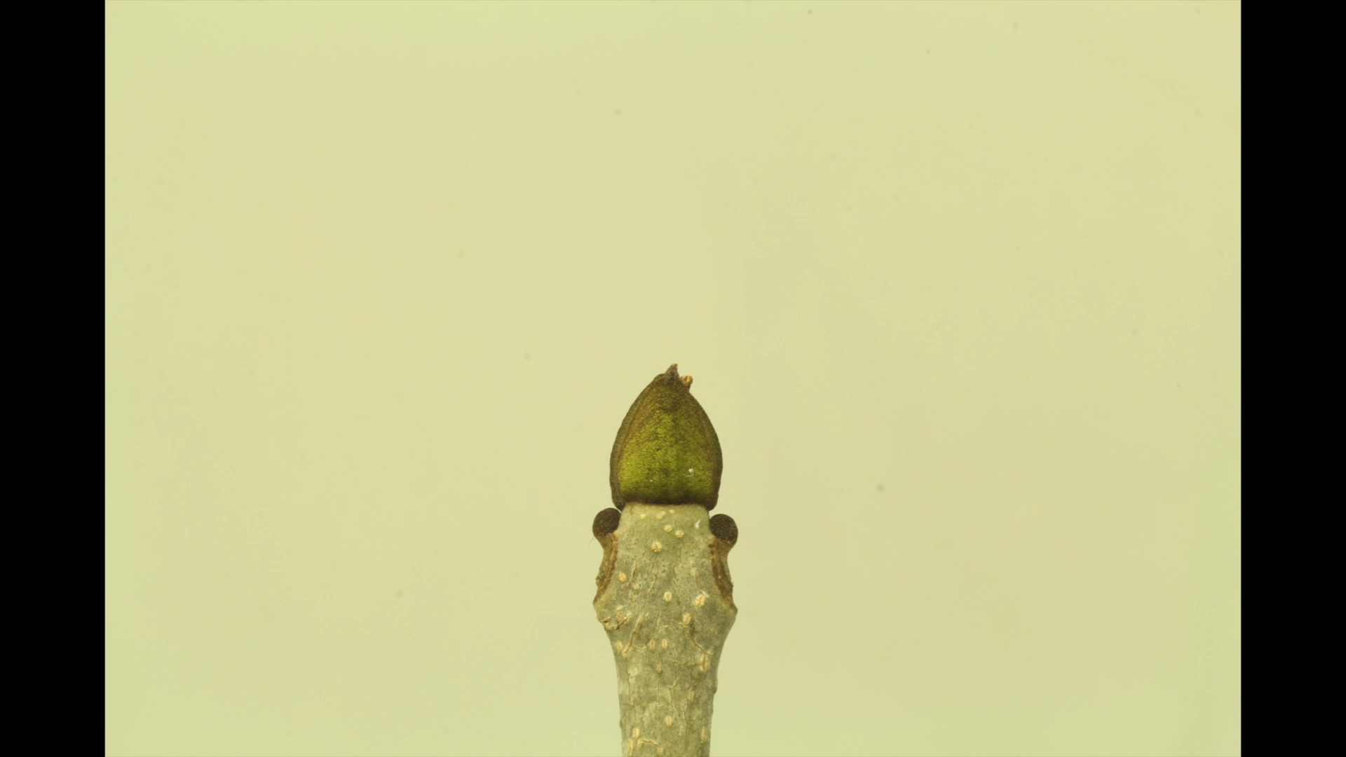
Why do we study phenology?

Slide 10
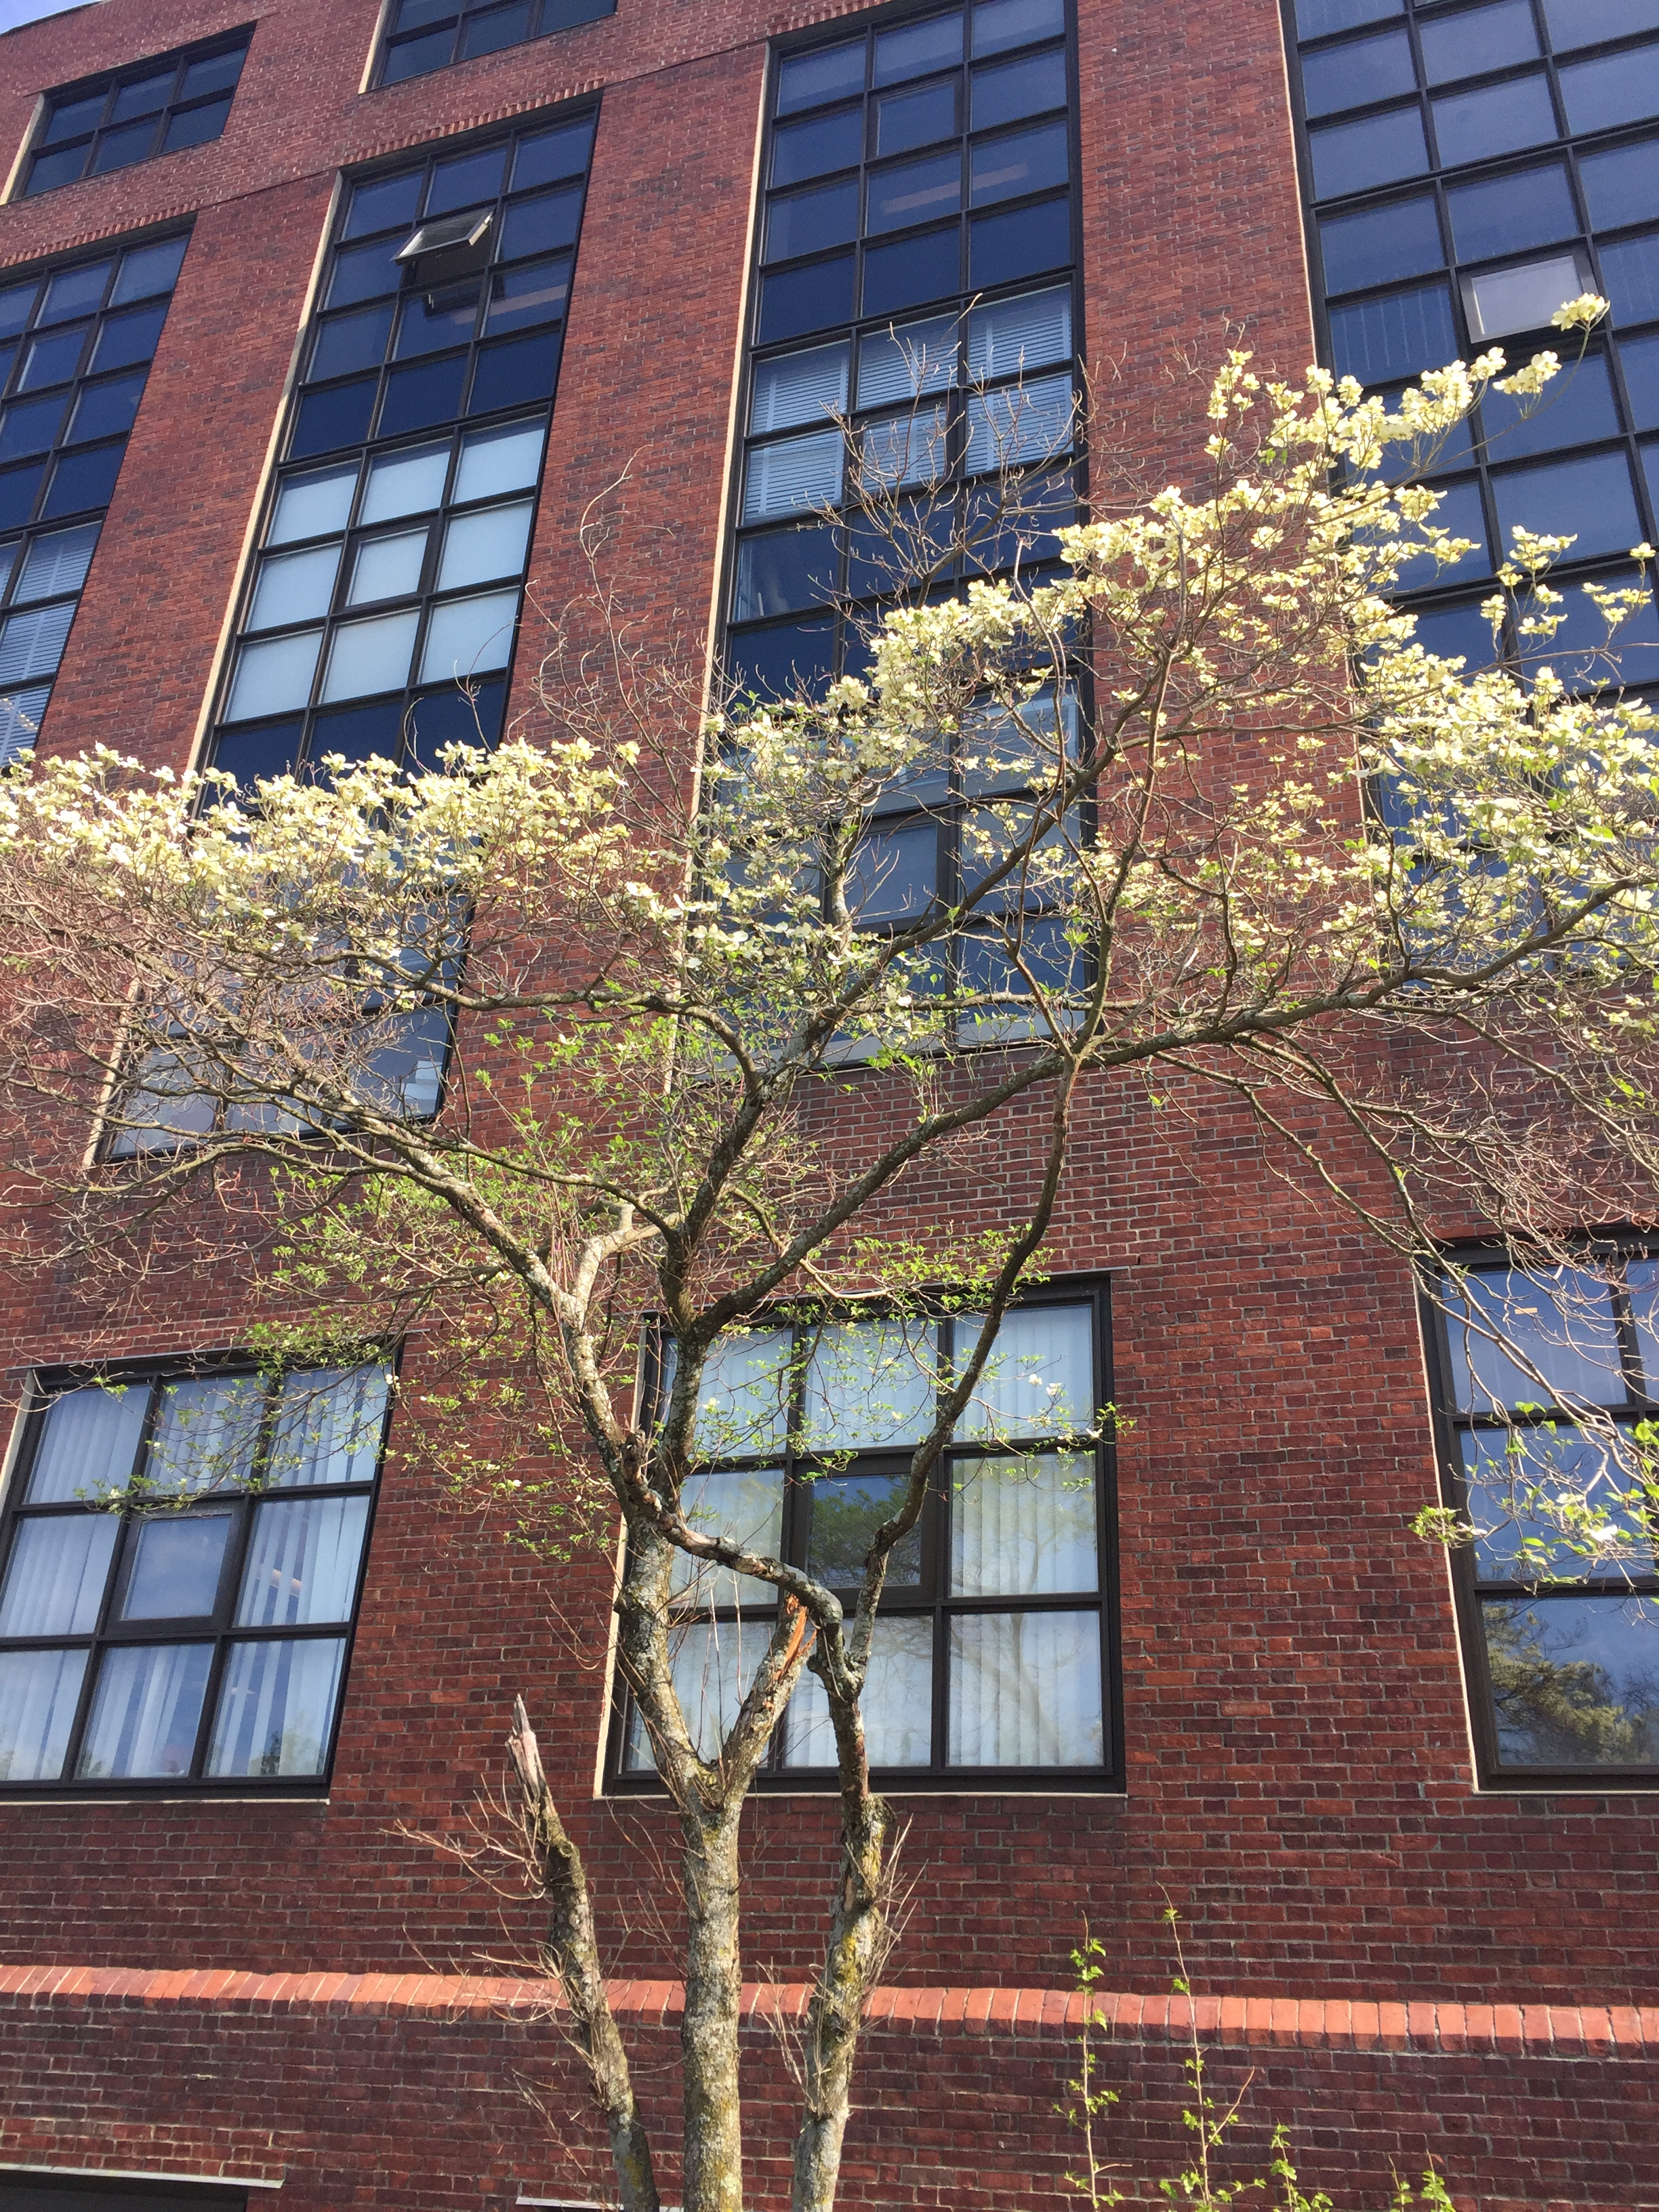
MICROCLIMATES: What are they and why do we care?

Slide 11

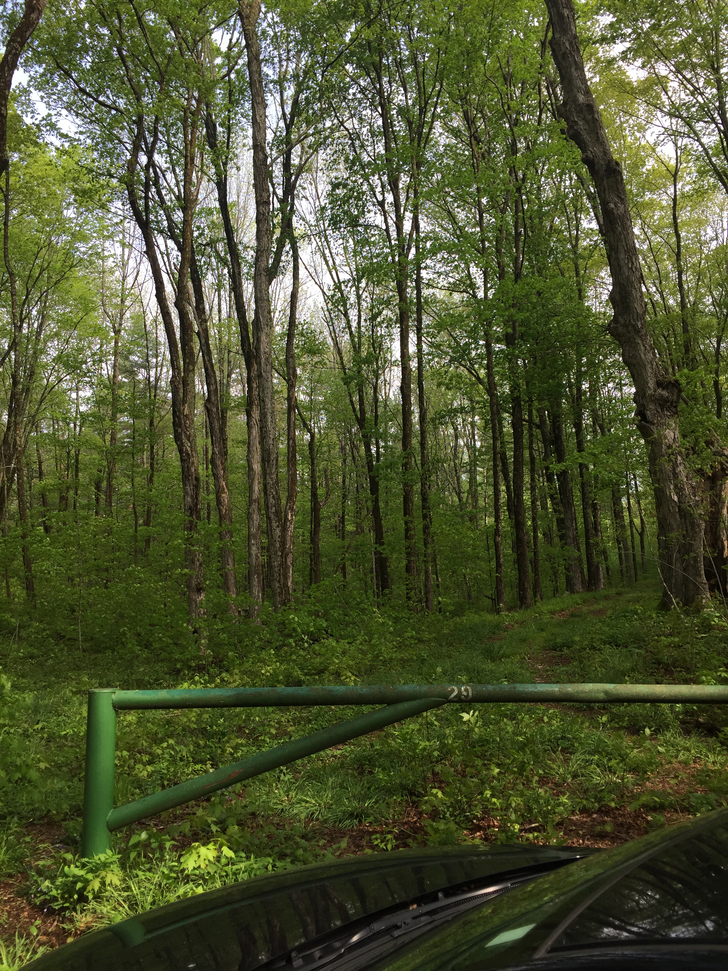
HOW WILL WE STUDY THIS?
HARVARD FOREST
ARBORETUM

Slide 12
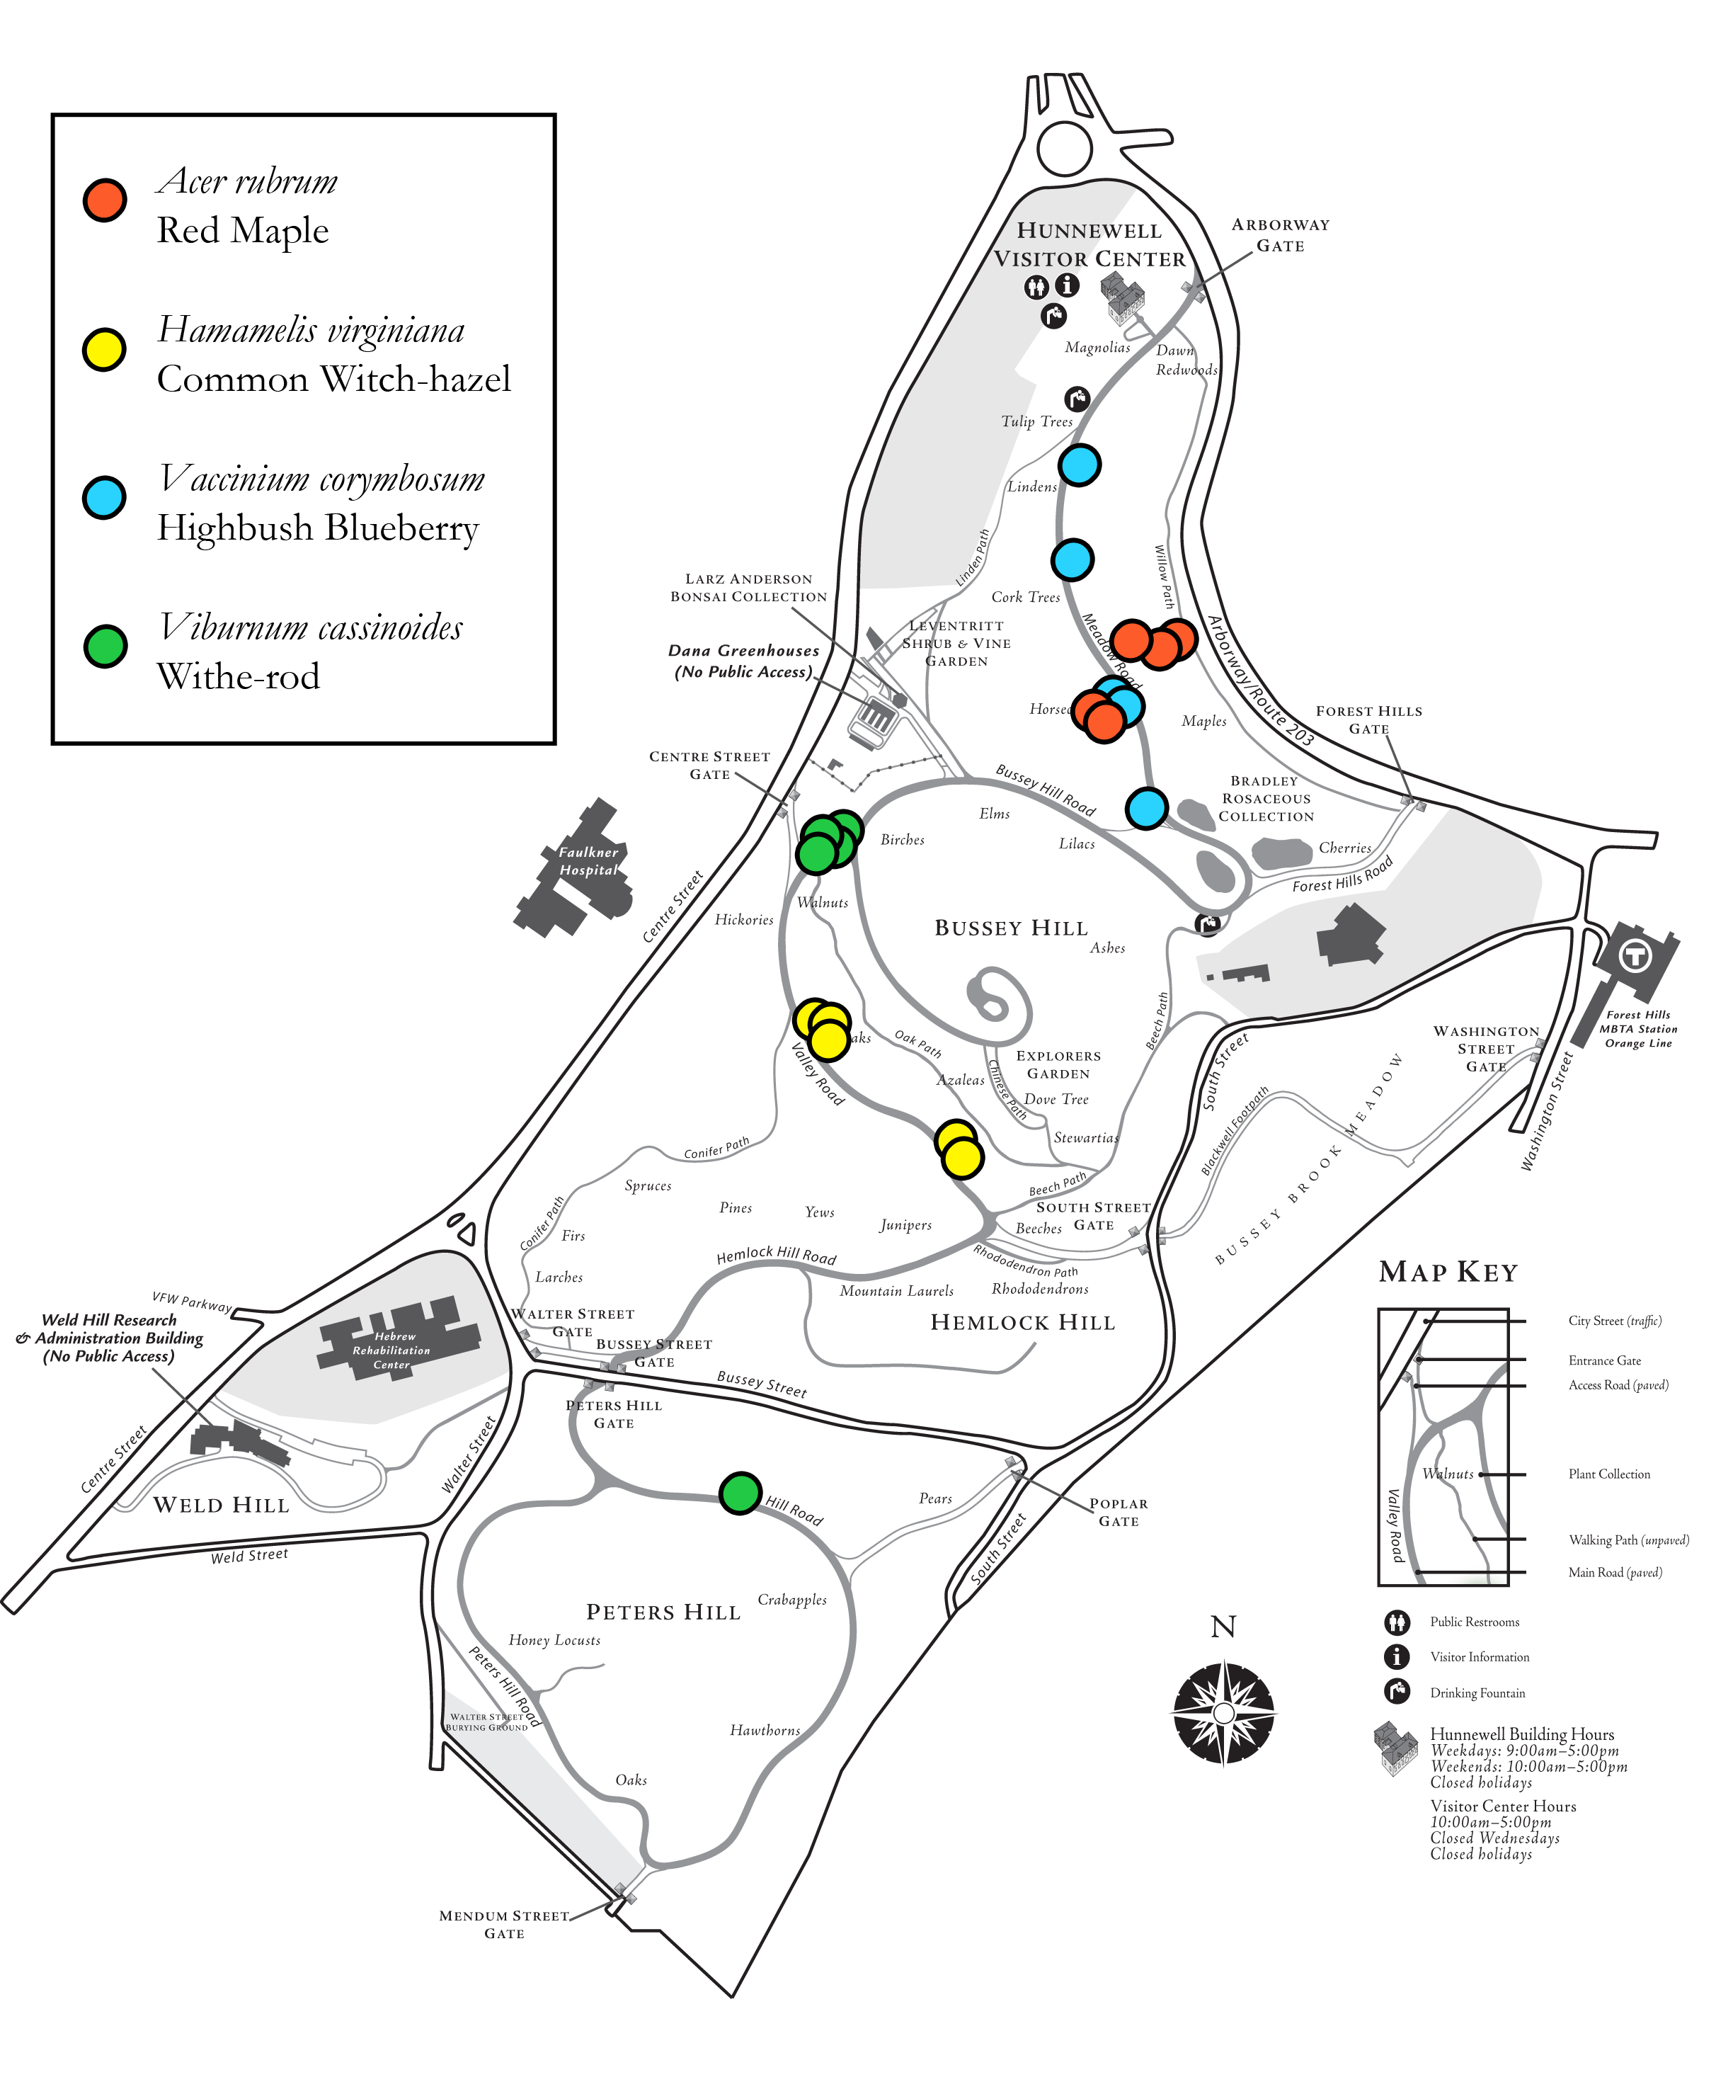
Highbush Blueberry
Red Maple
Viburnum (With-rod)
Witch-hazel

Slide 13
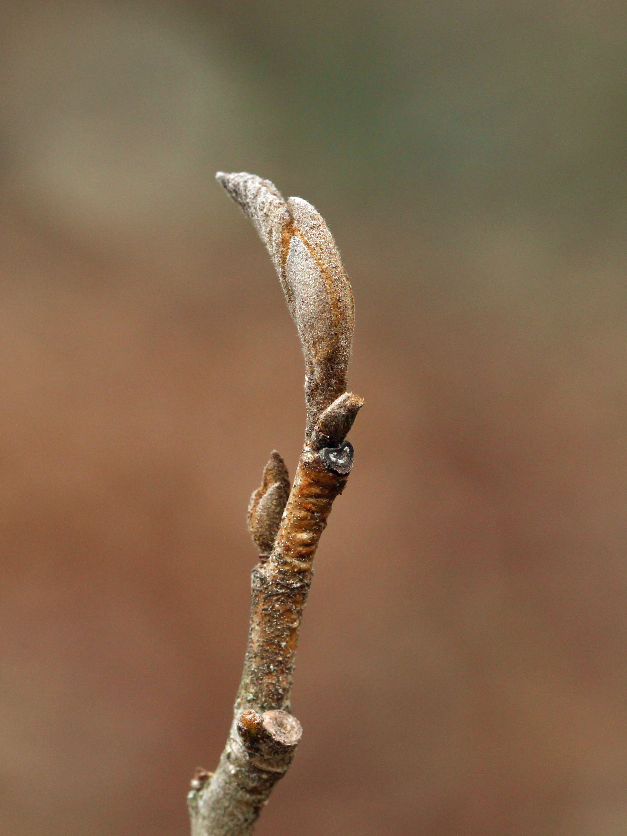
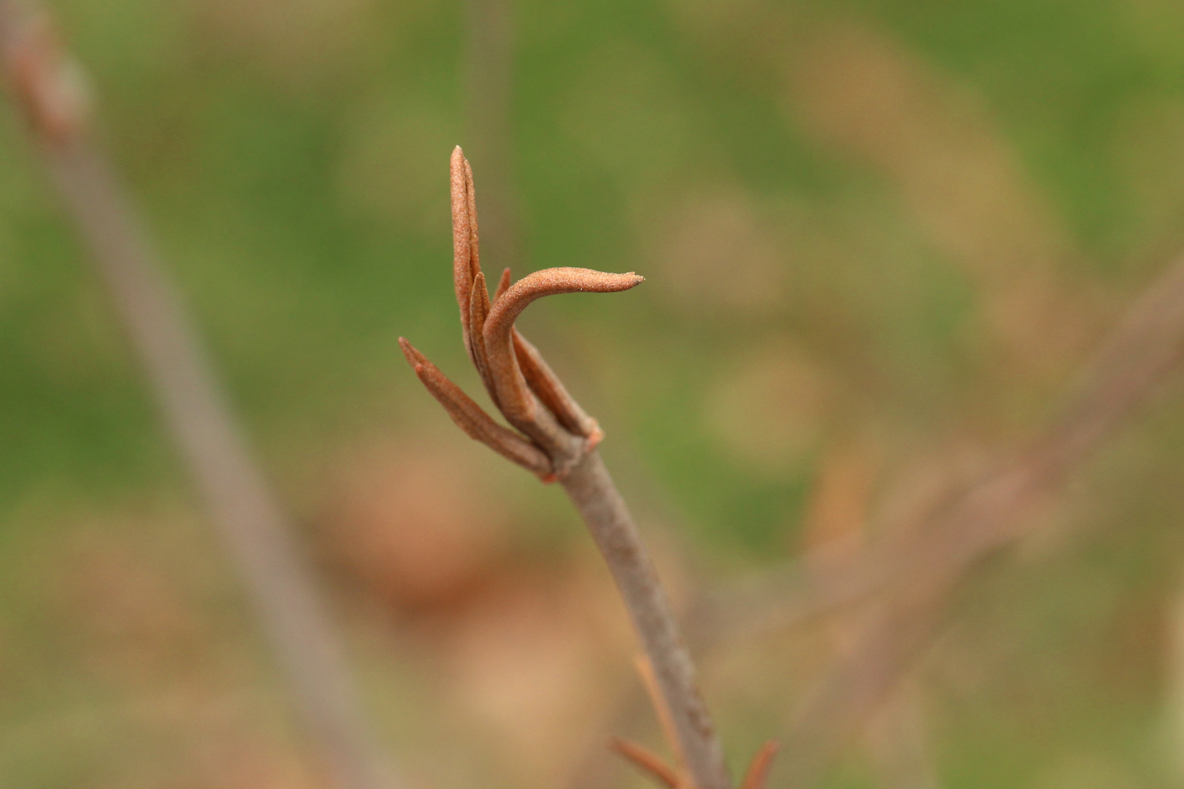
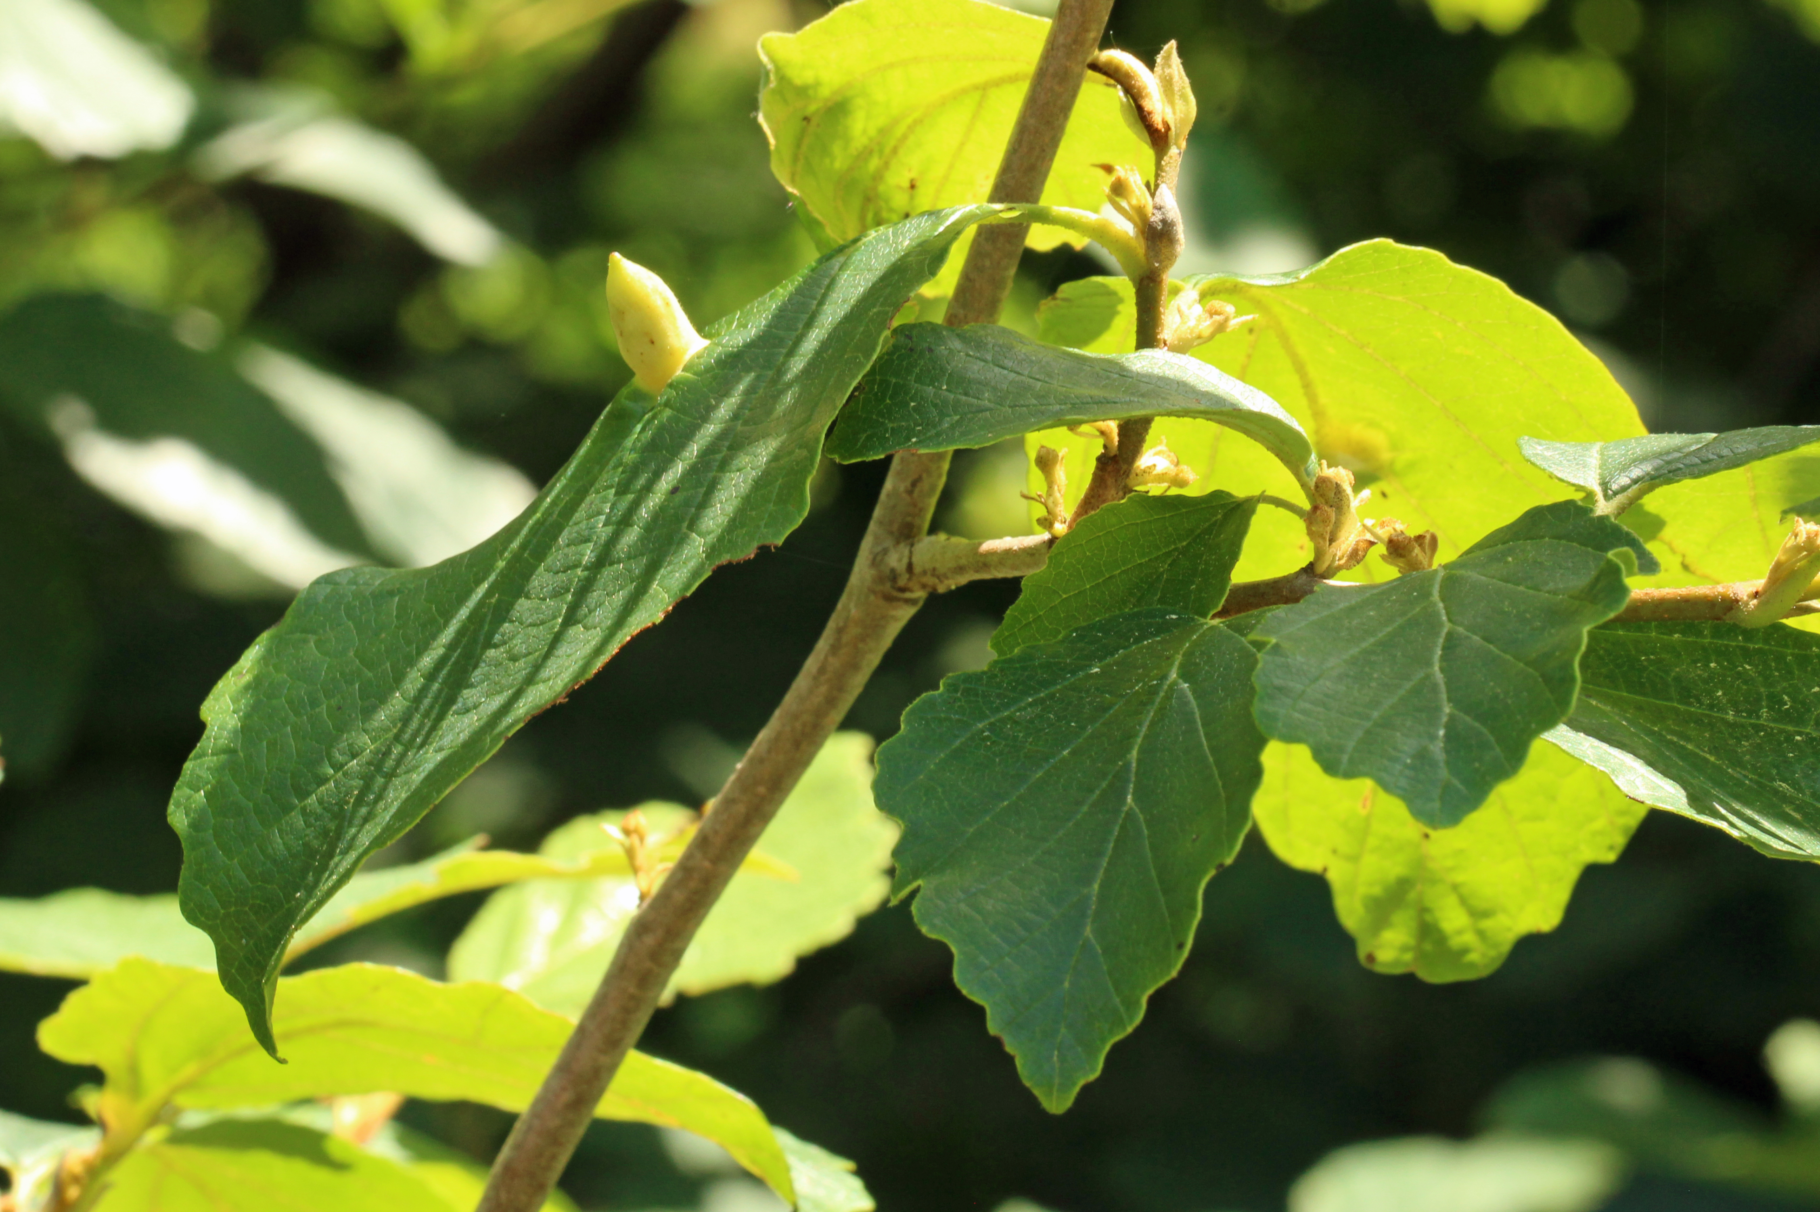
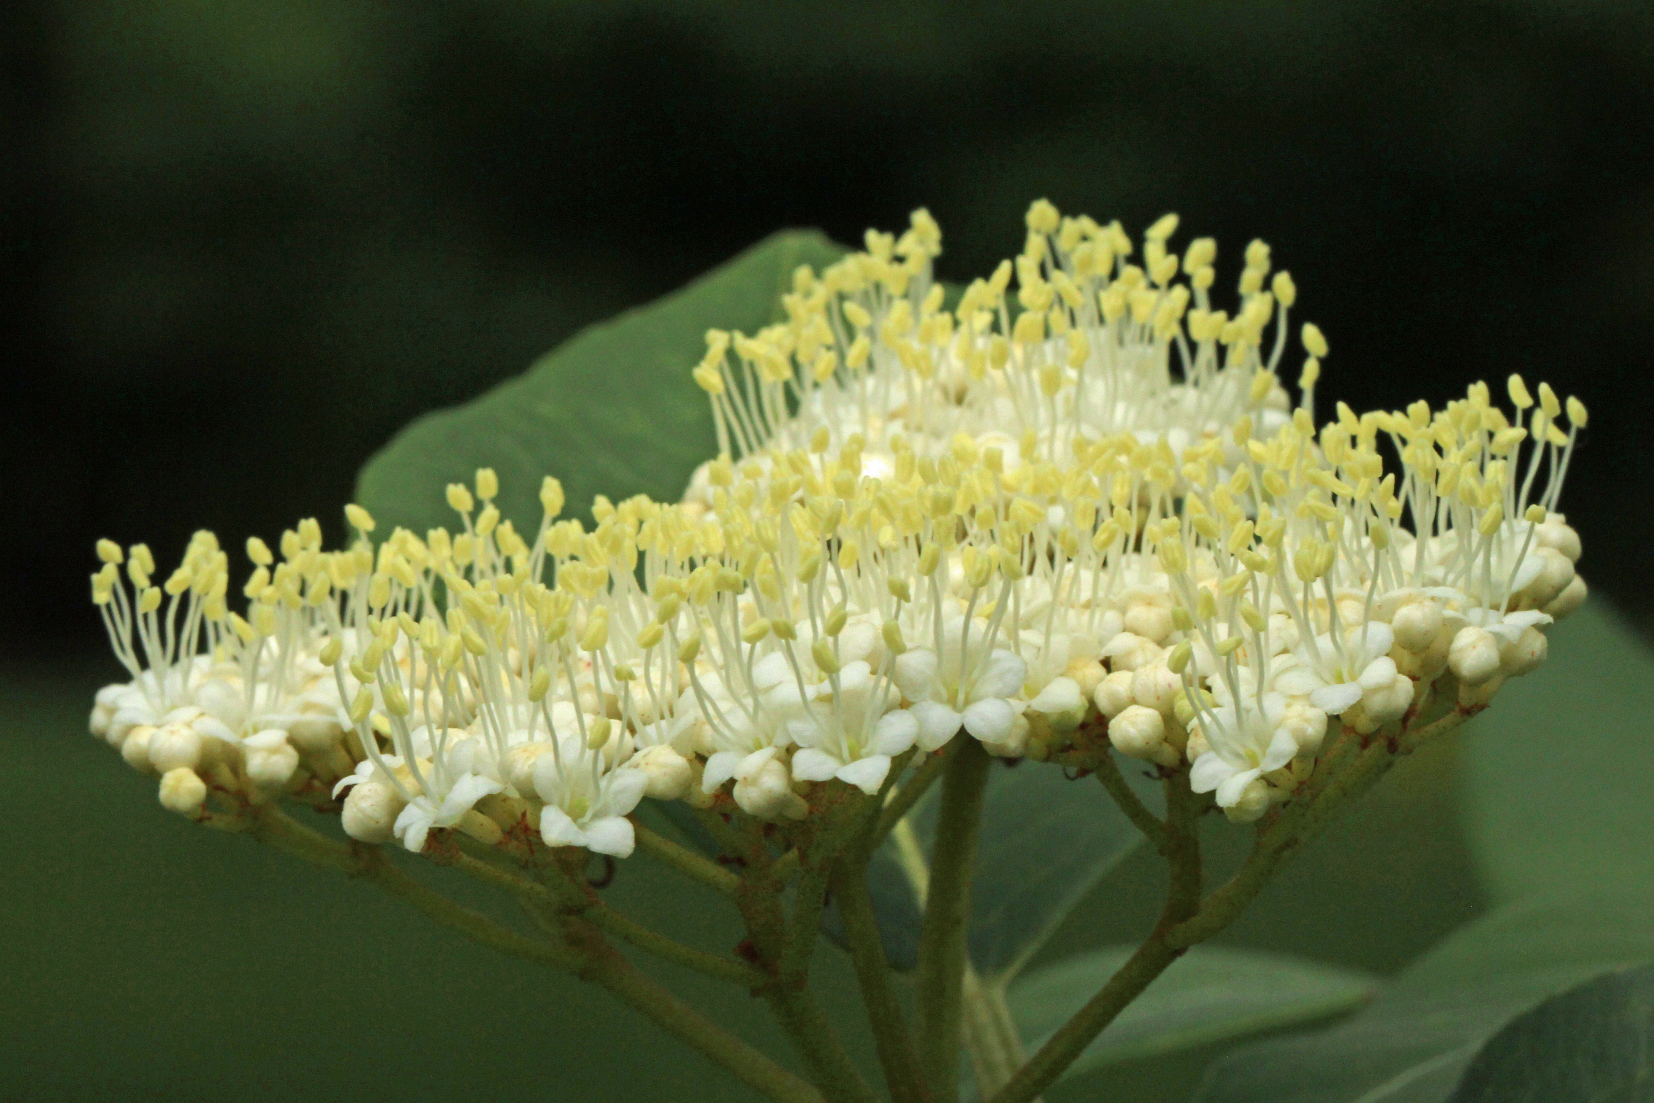
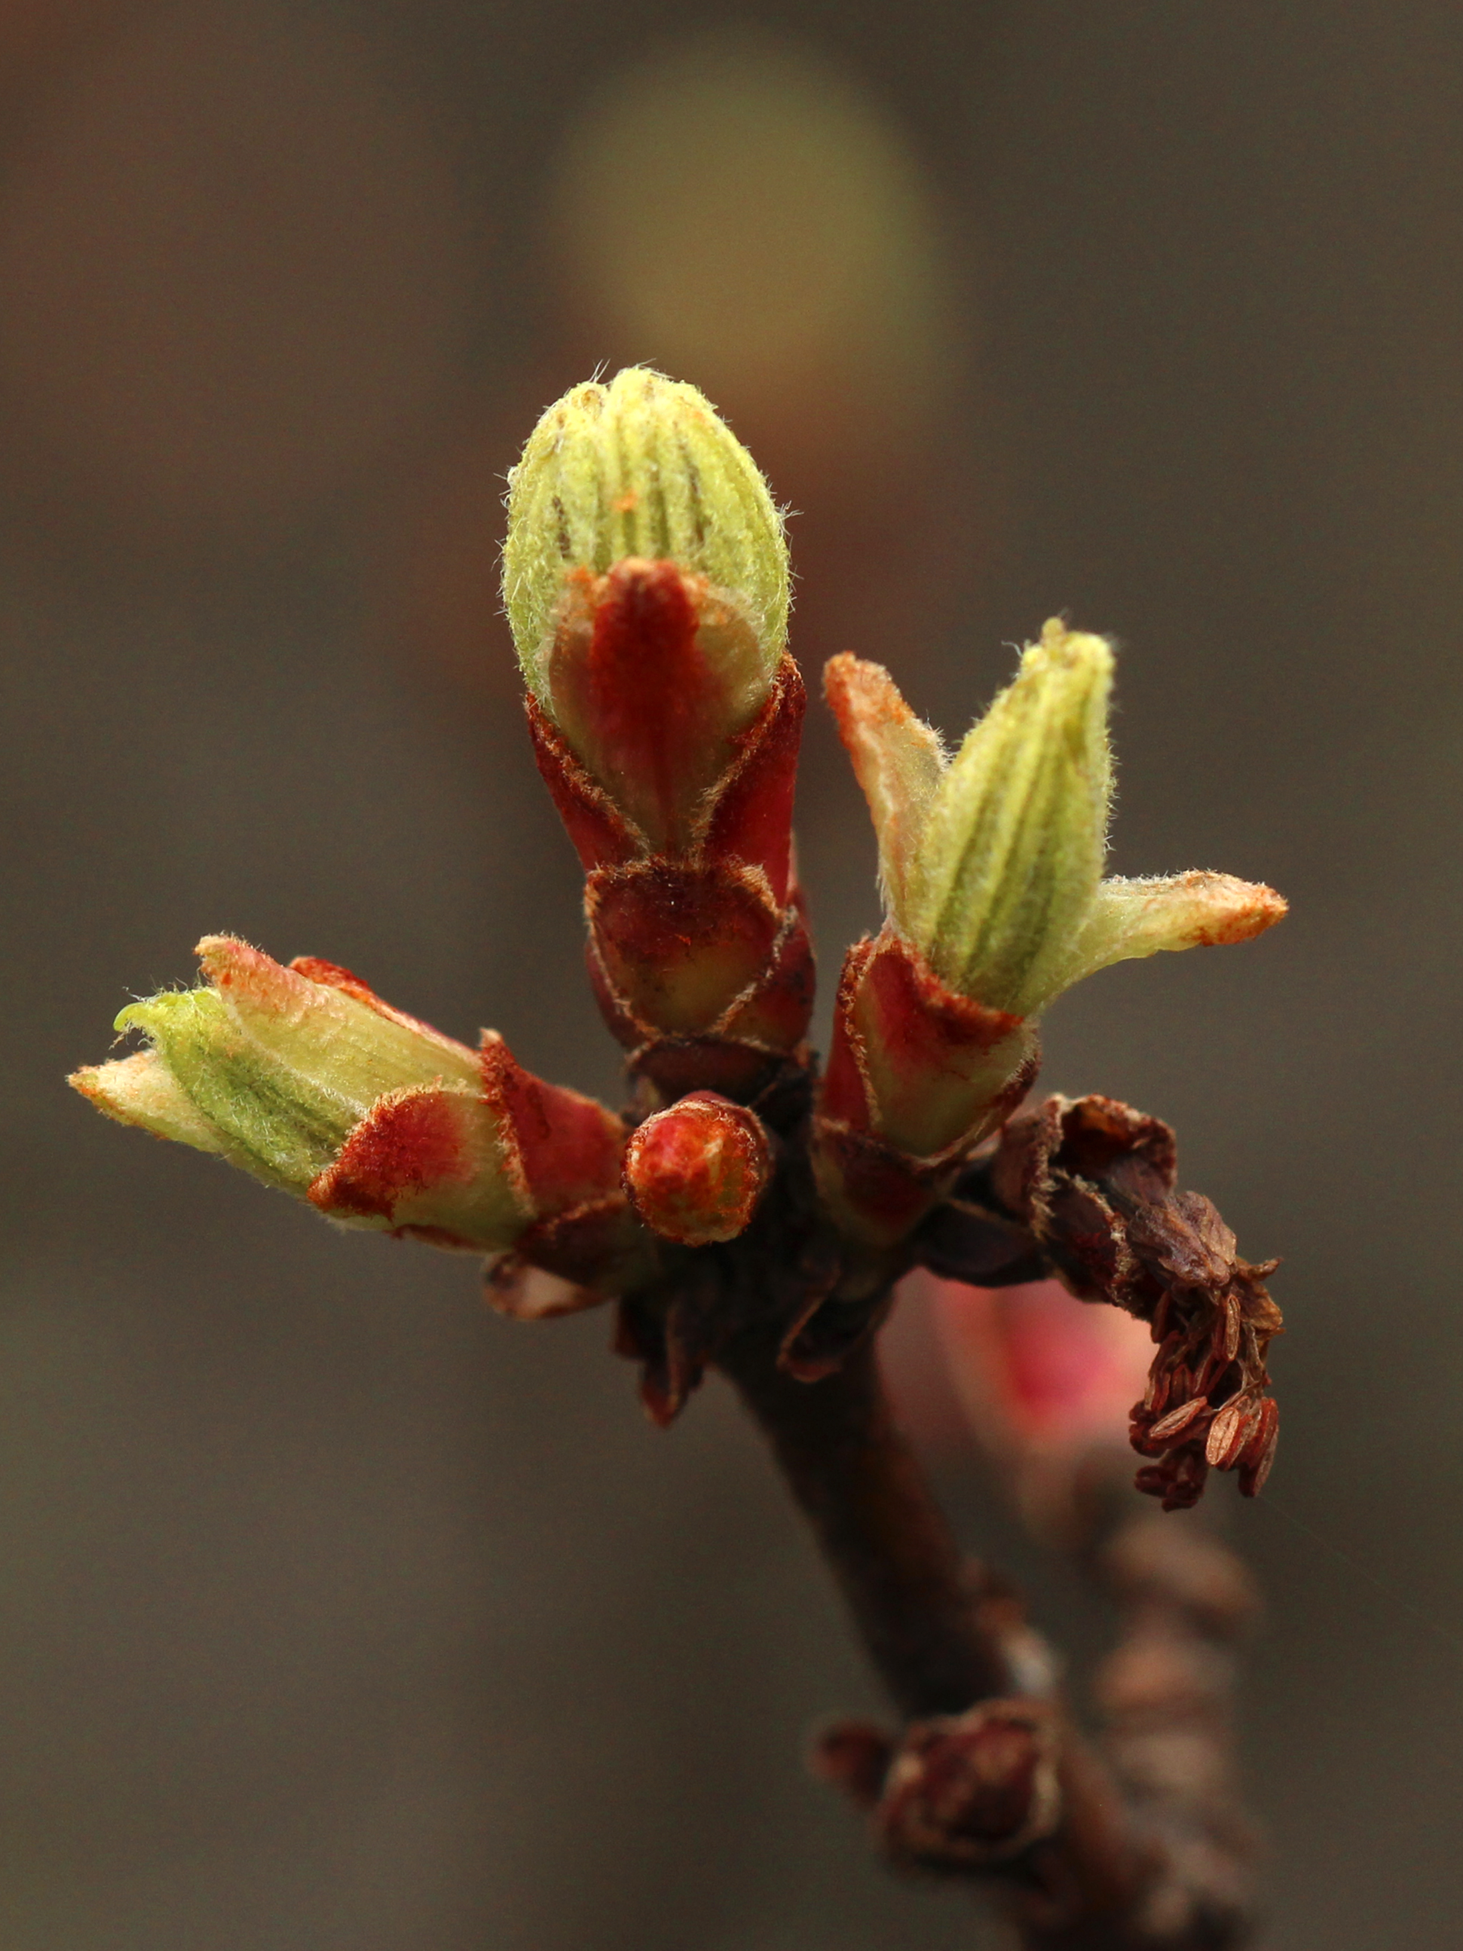
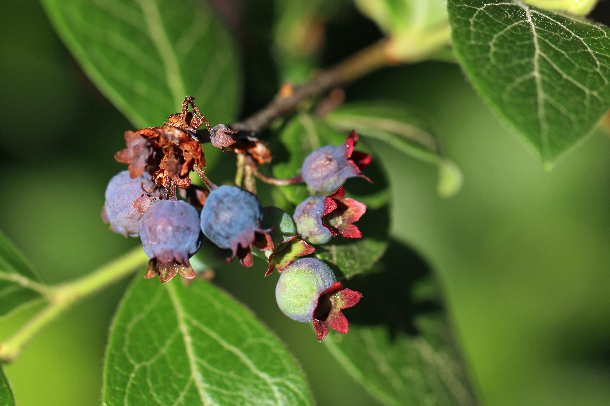
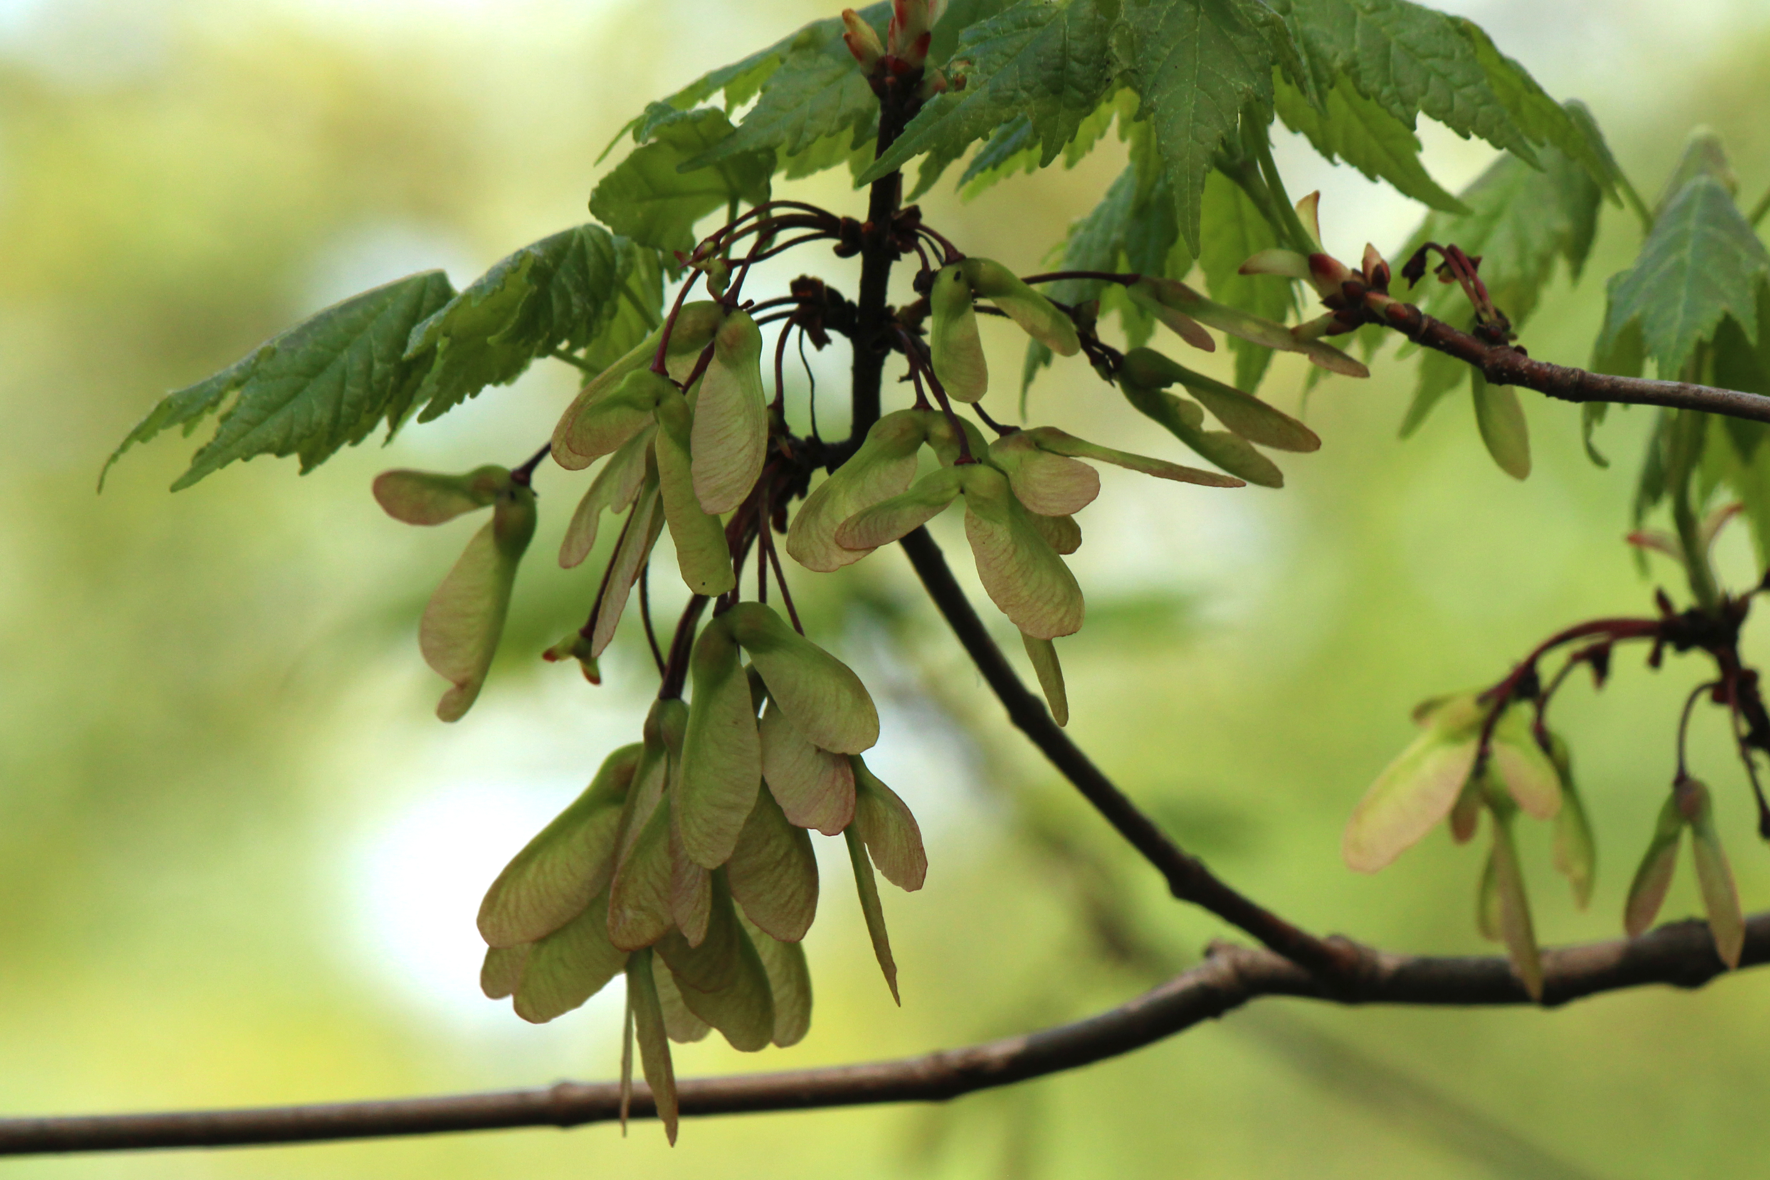
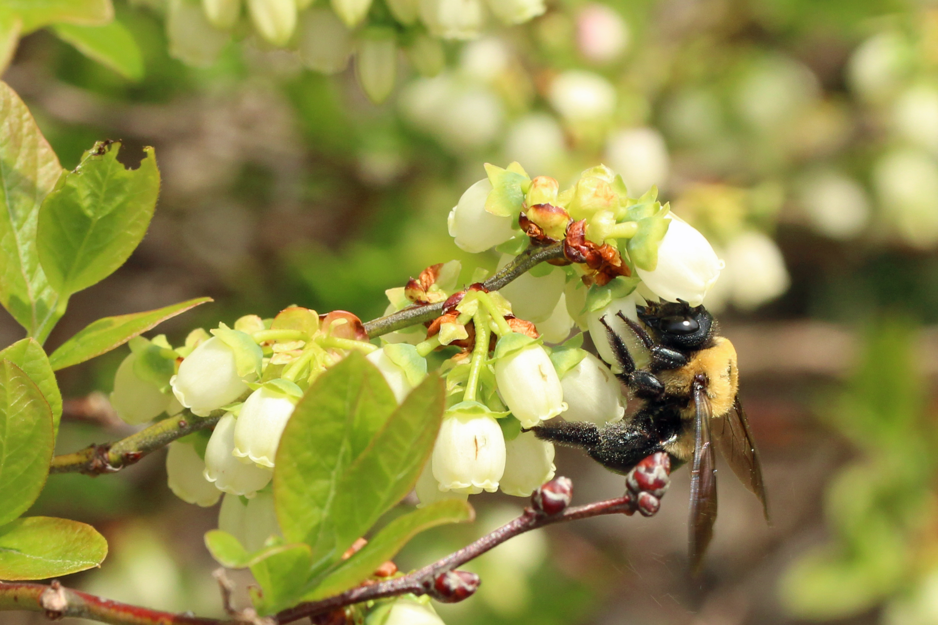
NEW SPECIES & A NEW ROUTE!

Slide 14
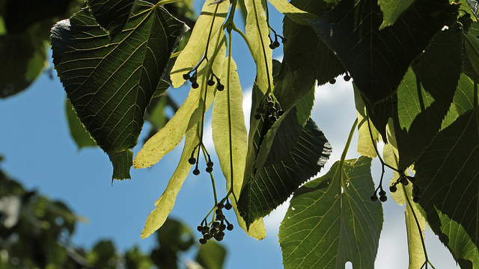
WHAT DO YOU WANT TO KNOW?

Slide 15
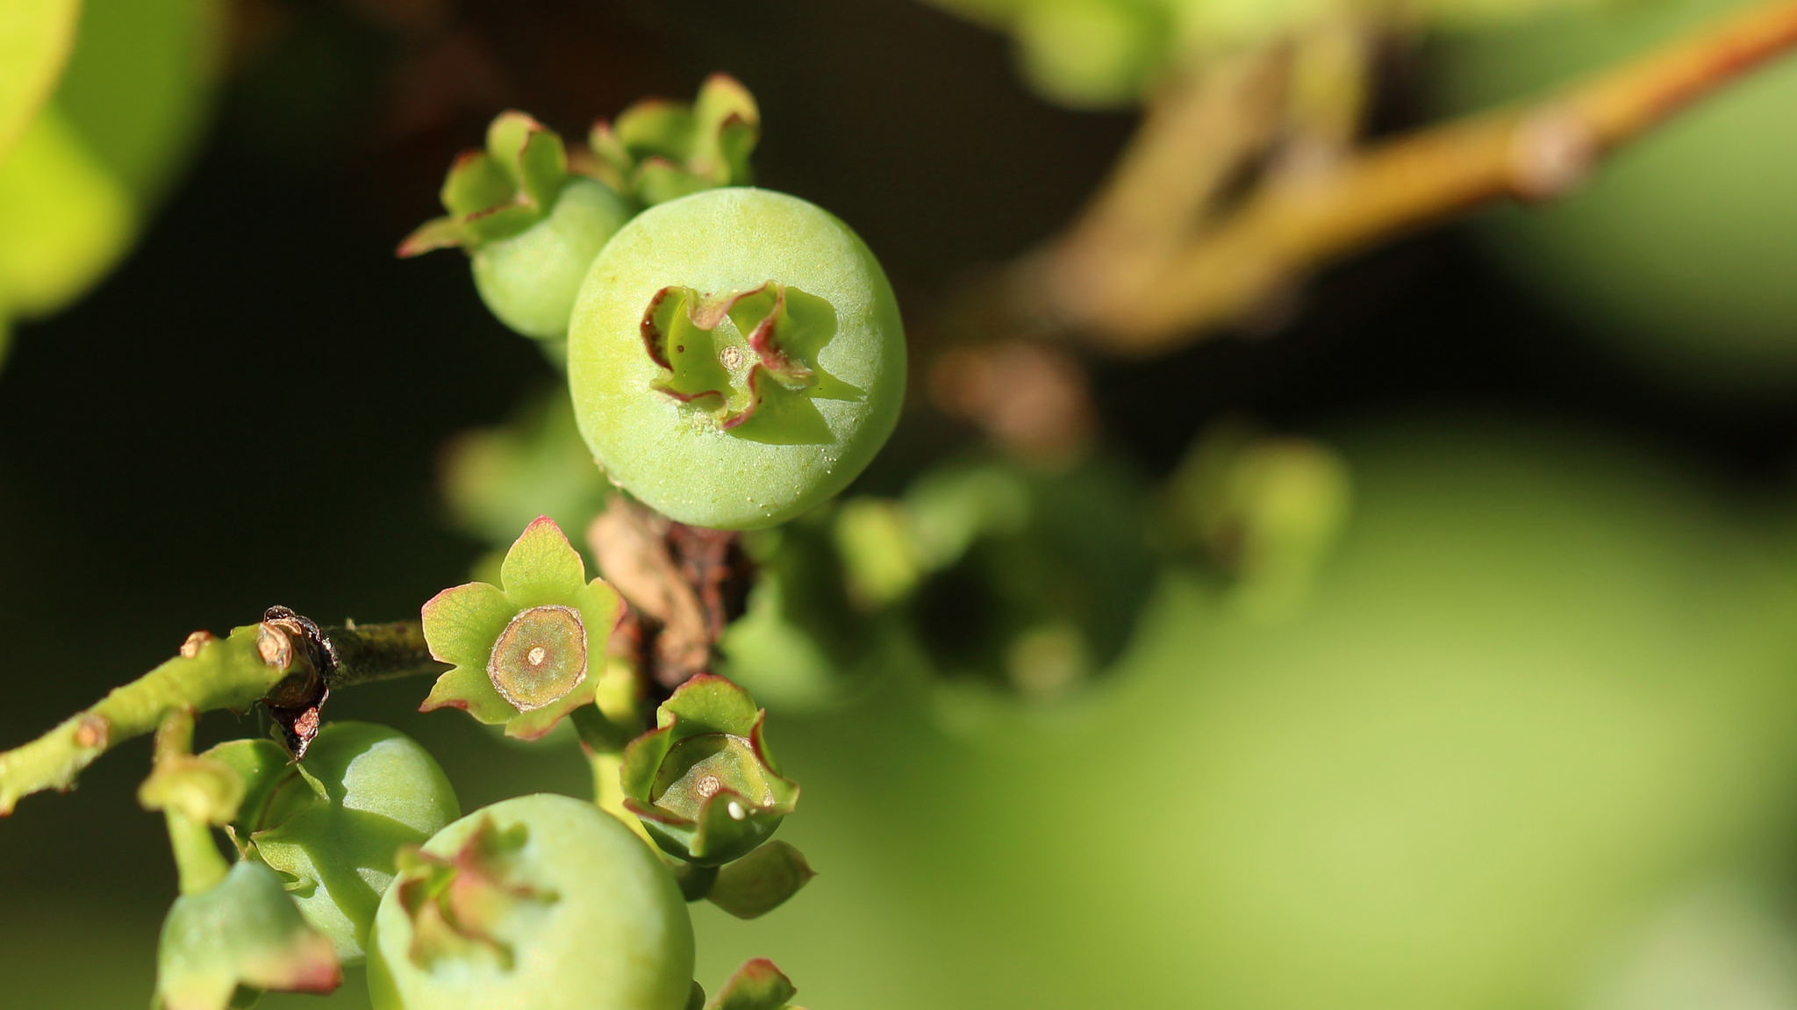
THANK YOU!!!

